Slide 1

CIT 244 Weeks 1 & 2
Professor: James Winyard

Slide 2



Today’s Concept’s
OOP CIT-130 Review – Part 1 & 2
All About Objects

Slide 3

Contents
Topic | Slide #
Course Video Information (And previous courses) | 4
What & Why - (Review Section Overview) | 5
What & Why – (Introduction to OOP) | 6 - 7
The Dog Example - Our first example of Object-Oriented Programming | 8 - 21
Constructors (Default & Overloaded) | 23 - 26
Reference Types | 28
Static VS Non-Static | 29 - 3
Visibility Modifiers | 36
UML Diagrams | 37 - 43
Pseudo Code | 44 - 46
Thinking In Objects | 47
Assignment(s)

Slide 4
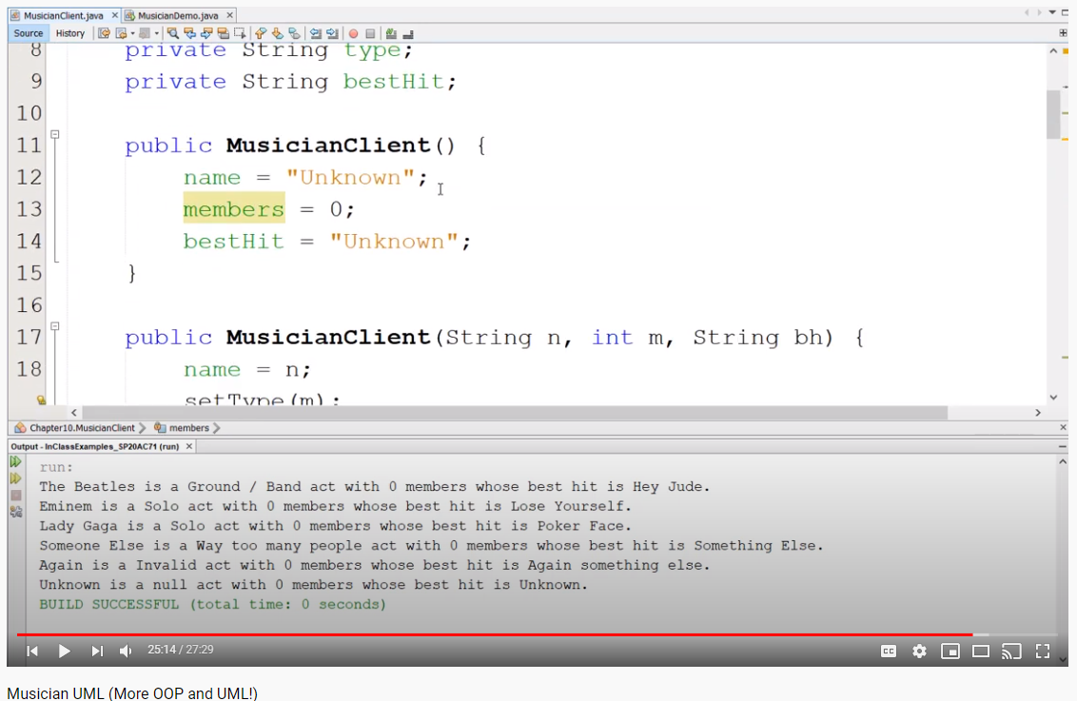
IMPORTANT: VIDEOS!
With each programming course I have taught I have produced videos of just about every programming exercise and topic covered. These seem to get great feedback from students and allow you not only to revisit topics that may not have entirely clicked in class, but also learn at your own pace.
On our blackboard course site I have listed ALL videos from my CIT-111 and CIT-130 courses if you would like to review any particular area, they are labeled be chapter / topic.
It is my goal to the same for CIT-244, you can expect videos posted weekly that cover:
Our regular in-class examples
PowerPoints
Various other explanations & content
You will again find links to these in our weekly course folders located on our blackboard course site. The first few weeks, again, will be OOP review, but new videos will be accessible once we leave the review portion of this class.

Slide 5
What & Why? (Review Section Overview)
This course involves Data Structures, Algorithms, Recursion, External APIs, GUIs & More! But, before that … We should review some OOP concepts to ensure we are all on the same page.
I understand many of you took CIT-130 last semester so these concepts may be fresh on your mind but for others this may be your first Java course in over a year, these concepts may have been blurry or breezed over in 130, so it is important to cover these key concepts again, to ensure we are all on the same page before diving into the new stuff.
What?
Week 1 - Introduction to OOP design
Week 2 - UML Diagrams & Modelling
Week 3 – Inheritance, Abstract Classes & Interfaces
Why?
To gain an understanding of OOP design patterns which will be crucial in various other aspects of this class discussed in future weeks.
Again, to ensure we are all on the page!

Slide 6
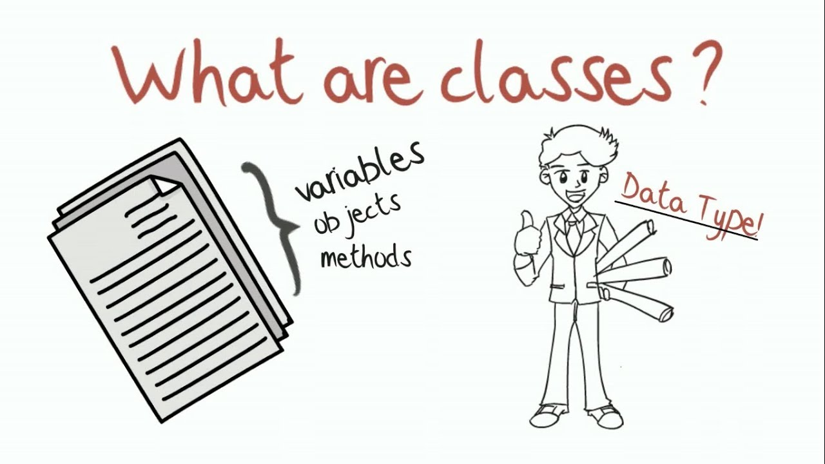
CIT 130 Classes & Objects
Professor: James Winyard

Slide 7
What & Why?
We now know and understand the use of methods but …
Although methods alone do take some pressure off the main method our data / program / methods are still not secure
We can use classes and objects to hide away and protect data we don’t want others to see or access
We can also use classes and objects to greatly reduce redundancy as we will see
What?
Multiple files working together as one
Only one of these files contains a main method
Secure/Private programs
Why?
Safe / Secure / Private
More efficient
Cleaner
Eliminates redundancies
Data Hiding
Why Make 100 of something when we can create 1 object and re-use it?

Slide 8

Example: Think of a Dog

Slide 9
Example: Think of a Dog
Let’s say we want to create this dog in java, well we will need some variables such as:
String dogName = “Some Name”;
String dogBreed = “Some Breed”;
String dogColor = “Tan/White”
int dogAge = 1;
boolean isTrained = false;

Slide 10

Example: Think of a Dog
Oh look, another dog! Time to make some more variables for this one
String dogName2 = “Some Other Name”;
String dogBreed2 = “Some Breed”;
String dogColor2 = “Tan/Brown”
int dogAge2 = 4;
boolean isTrained2 = true;

Slide 11

Example: Think of a Dog
Oh look, yet another dog! Time to make yet some more variables for this one
String dogName3 = “Yet Another Name”;
String dogBreed3 = “Some Other Breed”;
String dogColor3 = “White/Gray”
int dogAge3 = 6;
boolean isTrained3 = true;

Slide 12
Example: Think of a Dog
String dogName = “Some Name”;
String dogBreed = “Some Breed”;
String dogColor = “Tan/White”
int dogAge = 1;
boolean isTrained = false;
String dogName2 = “Some Other Name”;
String dogBreed2 = “Some Breed”;
String dogColor2 = “Tan/Brown”
int dogAge2 = 4;
boolean isTrained2 = true;
String dogName3 = “Yet Another Name”;
String dogBreed3 = “Some Other Breed”;
String dogColor3 = “White/Gray”
int dogAge3 = 6;
boolean isTrained3 = true;

Slide 13
Example: Think of a Dog
Did you notice something the last slide?
All of our dogs have a few (many) things in common …
They all have:
A name
A breed
A color
A age
Trained or Not

Slide 14
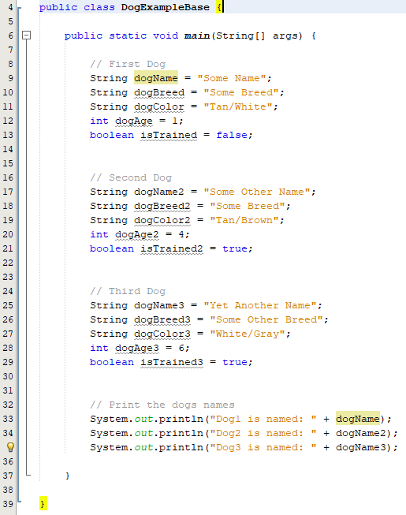
Example: Think of a Dog
That Means our program would require 5 of the same variable for each dog, imagine if we wanted a 4th, 5th, 6th, 1,000^{th!}

Slide 15
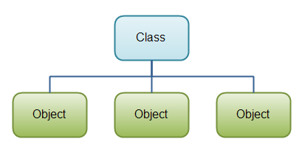
Creating a “dog object” using a separate class

Slide 16
Example: Think of a Dog
In a separate file we will create what I will refer to as a “shell” for our dog.
We know every one of our dogs has a:
Name
Breed
Color
Age
Trained or Not
Our “shell” or client class will contain place holders for all of these variables, each time we want to create a new dog we’ll just create a new one based on this shell, thus we are creating a new object.

Slide 17
The Next 2 Slides
The Next 2 Slides show the source code / output of our 2 newly created classes:
DogClient (The shell for a dog object)
DogDemo (Making use of the the DogClient shell)
The source code can be found on blackboard

Slide 18
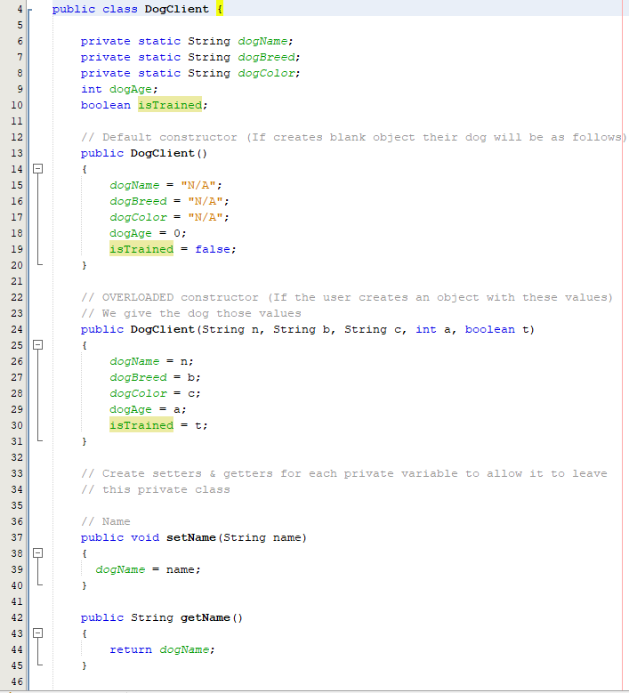
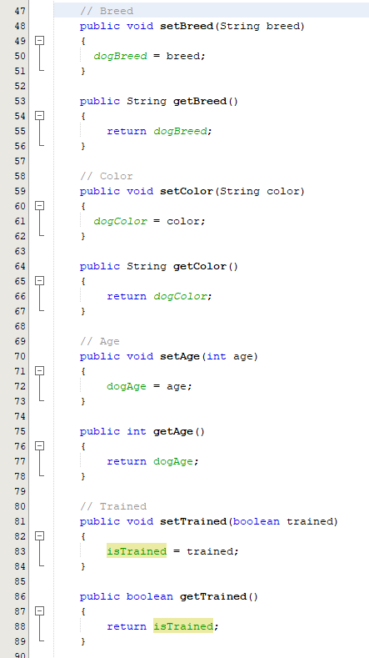
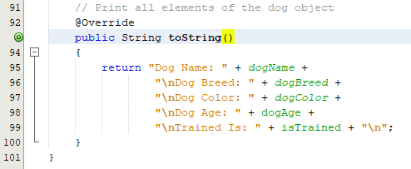
DogClient Class

Slide 19
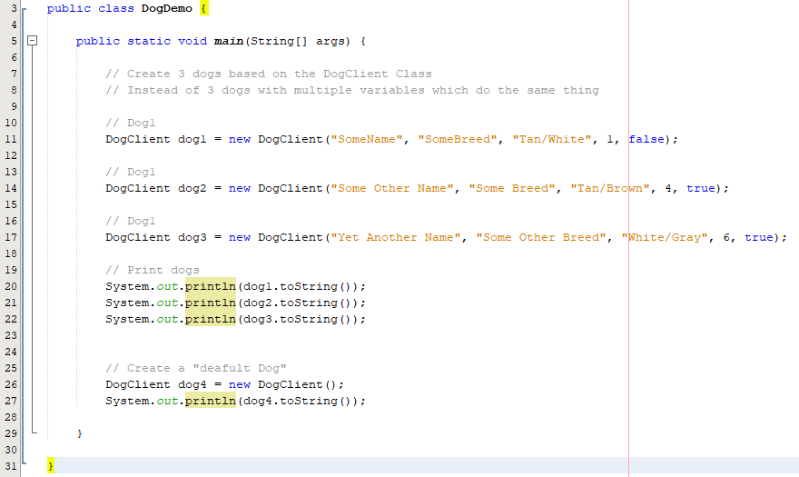
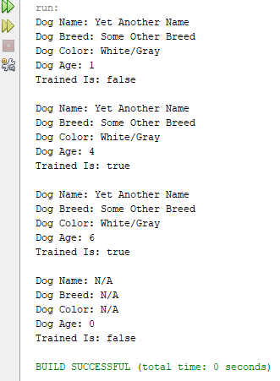
DogDemo Class
This Class creates an object based on the DogDemo class and fills in the data for each dog. Ultimately making this process much faster, easier, and smaller

Slide 20
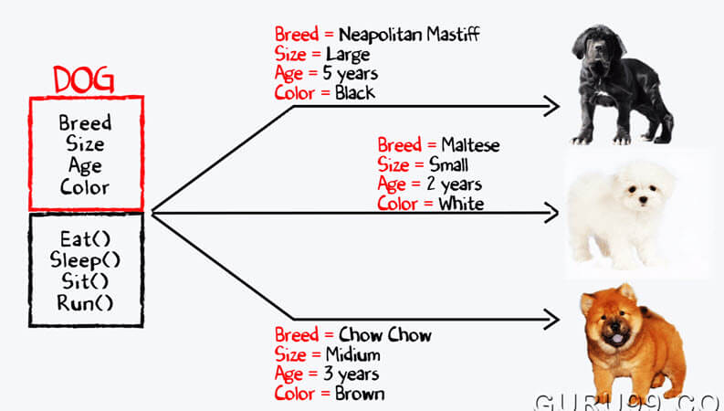
So …

Slide 21
Creating a “dog object” using a separate class

Slide 22
Let’s Create Our Own! Client/Demo Classes

Slide 23

Constructors
Think of a constructor as defining how an object will be made.
There are many ways in which some objects can be made so we are not limited to one constructor

Slide 24
Constructors The Rules
A constructor must have the same name as the class itself
Constructors do not have a return type – not even void
Constructors are invoked using the new operator when an object is created.
Constructors play the role of initializing objects.

Slide 25
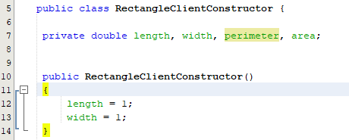
Constructors Default
A default constructor takes no arguments and instead within its body sets the default values.
That is, a default constructor will create “default” / “base” / “generic” object.
In other words the object created will not be user-defined but instead assume default values such as 1 and 1 or null values

Slide 26
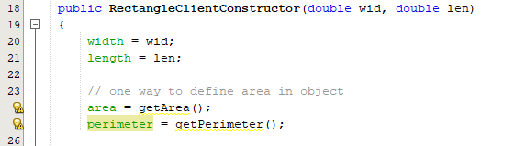
Constructors Overloaded
In English, overloaded may sounds like we have put too much into something. In OOP it simply means it is “not empty”
Passing one argument to a constructors parameters is overloading it. As is passing 1, 2, 3 .. 100 things.
Scanner scan = new Scanner(System.in) is overloaded with System.in
You can create as many overloaded constructors as you wish as long as the parameters are different

Slide 27
Reference Types

Slide 28

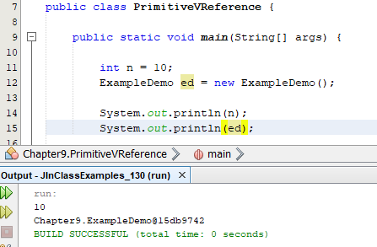
Primitive VS. Reference Types
A variable of primitive type holds a value of the primitive type. For example, int n = 10; i would print 10
A variable of a reference type such as an object or array holds not the value itself but a reference to where an object is stored in memory
toString() @Override

Slide 29
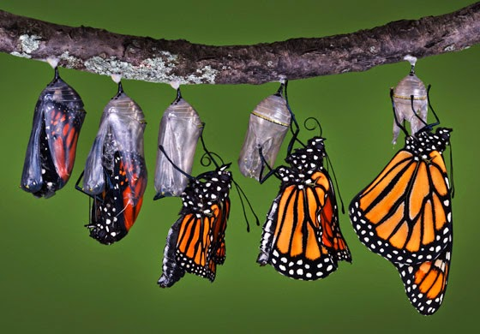
Static VS. Non-Static

Slide 30
Static VS. Non-Static (1)
Java is a Object Oriented Programming(OOP) language, which means we need objects to access methods and variables inside of a class. However this is not always true. While discussing static keyword in java, we learned that static members are class level and can be accessed directly without any instance. In this article we will see the difference between static and non-static methods.
Static Methods can access static variables without any objects, however non-static methods and non-static variables can only be accessed using objects.
Static methods can be accessed directly in static and non-static methods. For example the static public static void main() method can access the other static methods directly. Also a non-static regular method can access static methods directly.
Source: https://beginnersbook.com/2013/05/static-vs-non-static-methods/

Slide 31
Static VS. Non-Static - Usage
View code examples:
StaticExample
StaticExampleDemo

Slide 32
Static VS. Non-Static (2) - Sharing
We’ve learned thus far that each object we create is independent of each other.
Remember, the dog example? Instead of creating 5 variables for each dog we want to create we instead create 1 object which references the variables within the class and defines the object as such.
Think of the above statement. Each object we define. Dog1, Dog2, Dog3. Each dog may have the same types of variables, but no the same variables. For example they may all have String name, but they more than likely do not have the same value for name right?
Well, what if we want them to share certain values? Like family size. STATIC!

Slide 33
Static VS. Non-Static (2) - Sharing
A static variables is shared by all objects of a class.
If you want all instances (objects created) of a class to share data use must use static variables. Often referred to as class variables.
Static variables, store their values in a common memory location. Meaning the data will be shared unlike non-static variables.
Static variables can be called without creating an instance of the class (see slide 26)

Slide 34


Static VS. Non-Static (2) - Sharing
Think of the data on a family phone bill opposed to the data on multiple members of a family with individual bills.

Slide 35
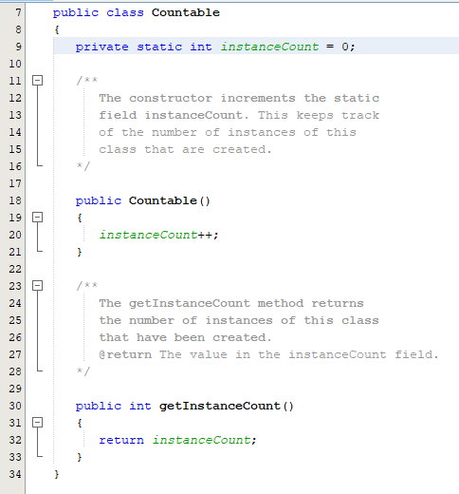
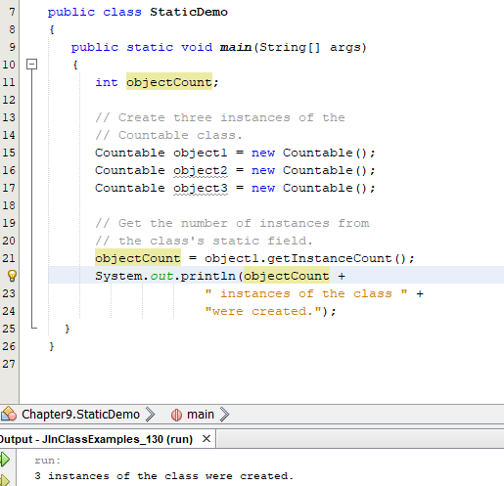
Static VS. Non-Static (2) - Sharing

Slide 36
Visibility Modifiers: Public, Private, Protected
Public: Is used for classes, methods and data fields to denote they can be accessed from ANY other class. By default, this is true and can be accessed by any class in the same package.
Private: Makes methods and data fields accessible only from within its own class What use is this, if no main method? - Use the “public loophole” to “escape” – See DogClient
Protected: We will learn this in - Chapter 11

Slide 37
UML Diagrams & Pseudo Code

Slide 38
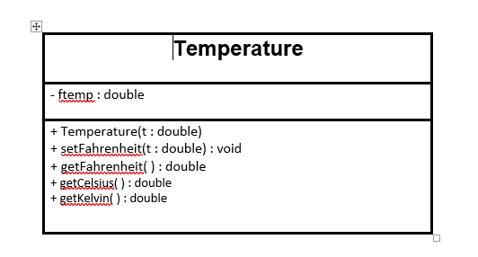
UML Diagrams
If I show you this image, what does it mean to you? Anything?
What is it asking?

Slide 39
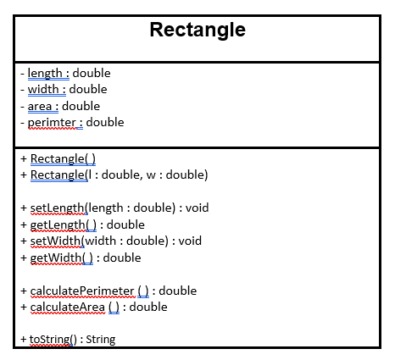
UML Diagrams
How about this one?
Familiar?

Slide 40
UML Diagrams
Unified Modeling Language
Visually represents a system along with its main actors, roles, actions, artifacts or classes, in order to better understand, alter, maintain, or document information about the system.

Slide 41
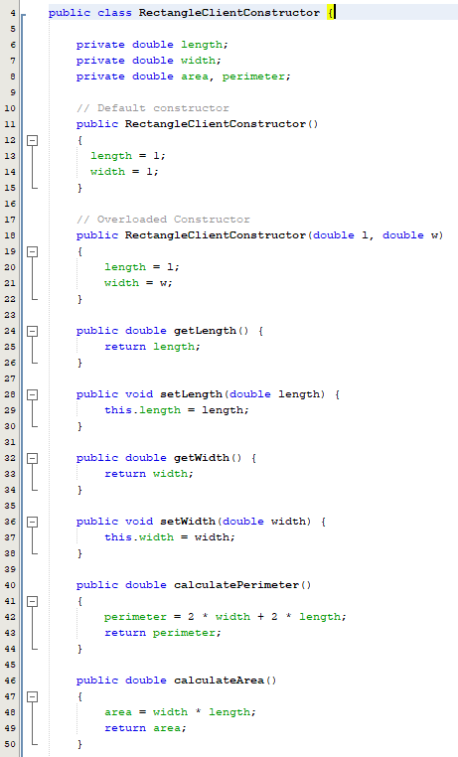
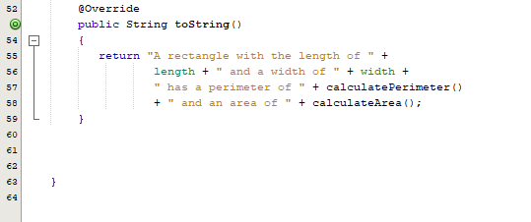
UML Diagrams
Remember this program?
Imagine if you were given
this as an assignment or exam
How would you be instructed
on what to do?
How would you know where to begin?
What to name things?
Etc …

Slide 42
UML Diagrams
Class Name
Symbol | Meaning
- | Private Visibility
+ | Public Visibility
name : type | Variable/Method name : data type
: return type | The return type of a given method
Variables
Methods

Slide 43
UML Diagrams: Try It!
Try to create the Temperature class
seen in the accompanying image.
Once complete, create a TempteratureDemo
class that invokes the class.

Slide 44
Pseudo Code
Our programs now are spanning multiple classes, methods and lines of code.
We can no longer really just “Sit and down and write code”, even if we can (a smaller program) pseudo code can be extremely useful.
It may seem like a simple thing to do (and it is!) but it is extremely beneficial and useful in creating any program.
Psuedo Code, is simply a written version of what/how/why your program will work

Slide 45
Pseudo Code
Psuedo Code, is simply a written version of what/how/why your program will work
Think of our lab assignments & exams. You are not just shown a picture or prompted with a scenario/problem to solve.
You are given step-by-step instructions of how to tackle a given scenario.
This is pseudo code!
Simply having something in writing (instructions) gives you a path to be paved. Instead of sitting down with a blank page and nothing to follow

Slide 46
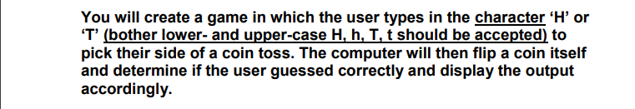
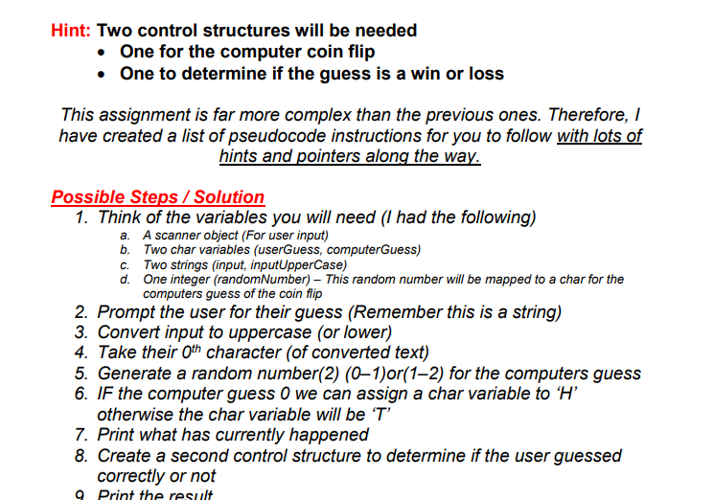
Pseudo Code
See how (below) makes (left) MUCH more manageable?
The Program
Pseudo Code

Slide 47

10.3 Thinking In Objects

Slide 48
Thinking In Objects
The procedural paradigm focuses on designing methods. The object-oriented paradigm couples data and methods together into objects. Software designs using the OOP focuses on objects and operations of objects.
Chapters 1 – 8 introduced fundamental programming techniques for problem solving. Given a problem you could likely solve it using the techniques learned here.
BUT,
Classes (& objects) provide much more flexibility and modularity for building reusable software.

Slide 49
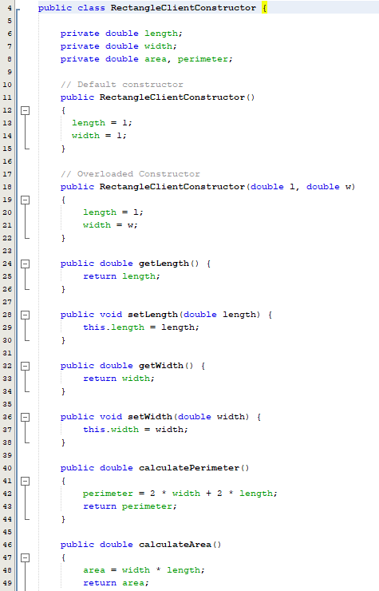
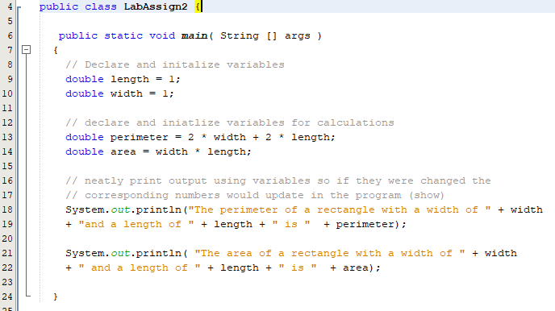
Thinking In Objects: Remember
VS

Slide 50
Assignments

